Slide 1



Weakly Supervised Person Name Transliteration using Twitter Data
for “Advanced Topics in Computer Science Course”
by Greenland Yu
Notes:
Hello and welcome to my presentation on Weakly Supervised Person Name Transliteration using Twitter Data. My name is Greenland.
My supervisors are Matt Lowry and Jason Sinn-yo-lay, my academic supervisor is Lingqiao Liu.

Slide 2
What is transliteration?
Converting a word from one writing system to another
Directly express through sounds
Transliteration is NOT translation
Notes:
Firstly, let me introduce what exactly is transliteration. Transliteration is the act of converting a word from one writing system to another. Transliterations express the word directly through sounds. Note that this is different from translations, translations instead convert the meaning of a word from one language to another.

Slide 3
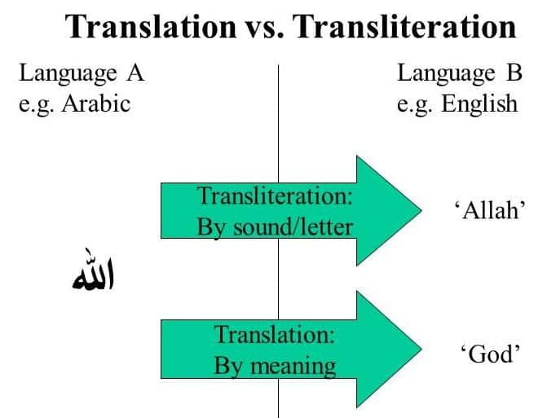
Notes:
As an example, going from Arabic to English, the Arabic word Allah transliterated would be Allah, we express the sounds of the Arabic word using English sounds. Allah translated would be God in English, here we express the meaning of the Arabic word in English.

Slide 4
Why keep looking into transliterating?
Standard transliteration systems already exist
Notes:
You might be wondering, why keep looking into transliterating? Surely the act of converting sounds of one language into another has already been implemented already. And you are correct, there exists standard transliteration systems for pretty much all language pairs.

Slide 5
Why keep looking into transliterating?
Standard transliteration systems already exist
Many self-transliterate
We are trying to capture this informal transliteration process
Counter-point
Notes:
However, when choosing a name, not everyone is going to use a standard transliteration system, many will self-transliterate their name. In this project we are interested in capturing this informal transliteration process. The produced system will provide an alternative transliteration to the standard transliteration systems.

Slide 6

A real-life application
Security vetting
Notes:
A real-life application of transliterations is the security vetting process. To accurately determine the profile of someone given a name, we would want to investigate documents in multiple languages. To identify the person of interest we need to search using a transliterated name.

Slide 7
The Project Goal
Create a name transliteration pipeline
Notes:
Now that we are properly motivated, we will have a look at the project goals. The overarching goal is to create a name transliteration pipeline that takes in raw Twitter data and produces a language model capable of transliterating between languages.
After the completion of this pipeline, the focus of this project is on experimentation on the Twitter data using this pipeline.
<not say>
Experiments include ways to increase model accuracy and decrease model loss by different methods of cleansing.
</not say>

Slide 8
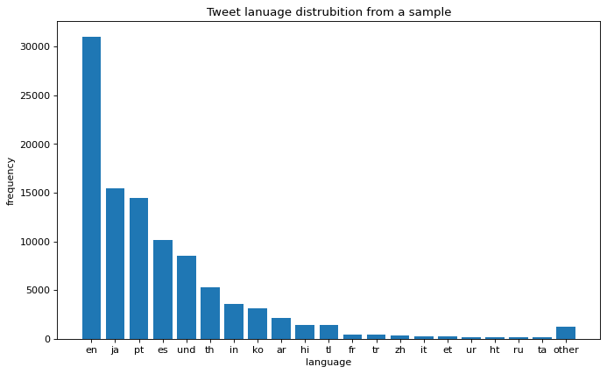
Data Source
Twitter Tweets
Global user space
However, very noisy data
Notes:
Twitter provides the data that is driving this whole operation. Twitter is chosen specifically because: it has a global user space,

Slide 9

Data Source – profile names
Screen name
User name
Notes:
And those users have to enter an English user name along with a screen name that can be in any language. Therefore, a user signing up to Twitter often chooses to transliterate their screen name when entering their username.

Slide 10
Data Source
Twitter Tweets
Global user space
However, very noisy data
Scope of data
In total 2 million Tweets
Each Tweet is in JSON format
Notes:
However, this is very noisy data as users do not have to provide a transliteration of their screen name. The solution to this problem will be explained in the cleansing section.
In total, this project used 2 million Tweets to perform analysis on.
Looking at a sample, Japanese was the most prevalent language other than English, for this reason the initial build of the pipeline used Japanese.

Slide 11
Methodology – An overview
Filtering
Cleansing
Training
Notes:
The bulk of this project’s work was creating the name transliteration pipeline. This pipeline can be separated into three distinct stages: Filtering, Cleansing and Training. I will now take you on a journey through the pipeline starting with the raw Twitter data.

Slide 12
The Data
{
"created_at":"Thu Mar 11 02:38:06 +0000 2021",
"id":1369840023508455426,
"id_str":"1369840023508455426",
"text":"東日本,
...
"user":{
...
"screen_name":"やさしい靴工房Belle＆Sofa＠うぇ部💛",
"user_name":"BelleSofa",
...
"lang":"ja",
...
}
Notes:
The raw Twitter data is in the form of numerous JSON Tweets, the fields we are interested in

Slide 13
The Data
{
"created_at":"Thu Mar 11 02:38:06 +0000 2021",
"id":1369840023508455426,
"id_str":"1369840023508455426",
"text":"東日本,
...
"user":{
...
"screen_name":"やさしい靴工房Belle＆Sofa＠うぇ部💛",
"user_name":"BelleSofa",
...
"lang":"ja",
...
}
Notes:
are the Tweet author user_name, the Tweet author screen_name and Tweet language.

Slide 14
Filtering – Using Tweet Language
Notes:
We perform an initial filter using the Tweet language to only obtain Tweets in the language we are interested in, say Japanese.

Slide 15
Filtering
{
"created_at":"Thu Mar 11 02:38:06 +0000 2021",
"id":1369840023508455426,
"id_str":"1369840023508455426",
"text":"東日本,
...
"user":{
...
"screen_name":"やさしい靴工房Belle＆Sofa＠うぇ部💛",
"user_name":"BelleSofa",
...
"lang":"ja",
...
}
A name pair
(BelleSofa,
やさしい靴工房Belle＆Sofa＠うぇ部💛)
Notes:
Then we extract out the user name and screen name fields to create a name pair. As you can see the name pair is not in the format we expect it to be, especially the screen name where characters that are not part of the Japanese language is present.

Slide 16
Filtering – On screen name
やさしい靴工房Belle＆Sofa＠うぇ部💛
やさしい靴工房うぇ部
Notes:
Thus, we perform a second filter on the screen name using regex to remove all characters that are not part of the target language. As a side effect, emojis are also removed in the process.

Slide 17
Cleansing
Name pairs are evaluated
We are only interested in name pairs that are transliterations
Notes:
We now move onto the cleansing stage where name pairs are evaluated to see if they are legitimate transliterations of each other. This is because when users enter their user name and screen name, it can be anything they want. And we are only interested in the name pairs where the user has self-transliterated the screen name into user name.

Slide 18
Cleansing – Pre-processing of user name
Kanye_WestFan1991
Notes:
The cleansing stage also performs a number of pre-processing steps to further clean the names coming in from the filtering stage. Pre-processing applied to the user name include:

Slide 19
Cleansing – Pre-processing of user name
Kanye_WestFan
Notes:
removing numbers,

Slide 20
Cleansing – Pre-processing of user name
Kanye WestFan
Notes:
changing underscores to spaces,

Slide 21
Cleansing – Pre-processing of user name
Kanye West Fan
Notes:
adding a space between lower case and upper case characters

Slide 22
Cleansing – Pre-processing of user name
kanye west fan
Notes:
and finally case folding.

Slide 23
Cleansing – Pre-processing of user name
Kanye_WestFan1991
kanye west fan
Notes:
And here we see the whole process in action

Slide 24
Edit-distance
A measure of how similar two strings are
How many edits from one string to another
Edits:
Additions
Deletions
Substitutions
Notes:
Before getting into the nitty gritty of how we deduce legitimate name pairs, I will first introduce edit-distance. Edit-distance is a measure of how similar two strings are. And it is defined as how many edits need to be applied to go from one string to another. Edits can be in the form of additions, deletions and substitutions.

Slide 25
Edit-distance Example
To go from “kitten” to “sitting” we need 3 edits
kitten -> sitten
sitten -> sittin
sittin -> sitting
Notes:
For example the edit distance for the strings “kitten” and “sitting” is three. As the edits are: k turns into s, e turns into i and addition of g has to occur to transform kitten into sitting.

Slide 26
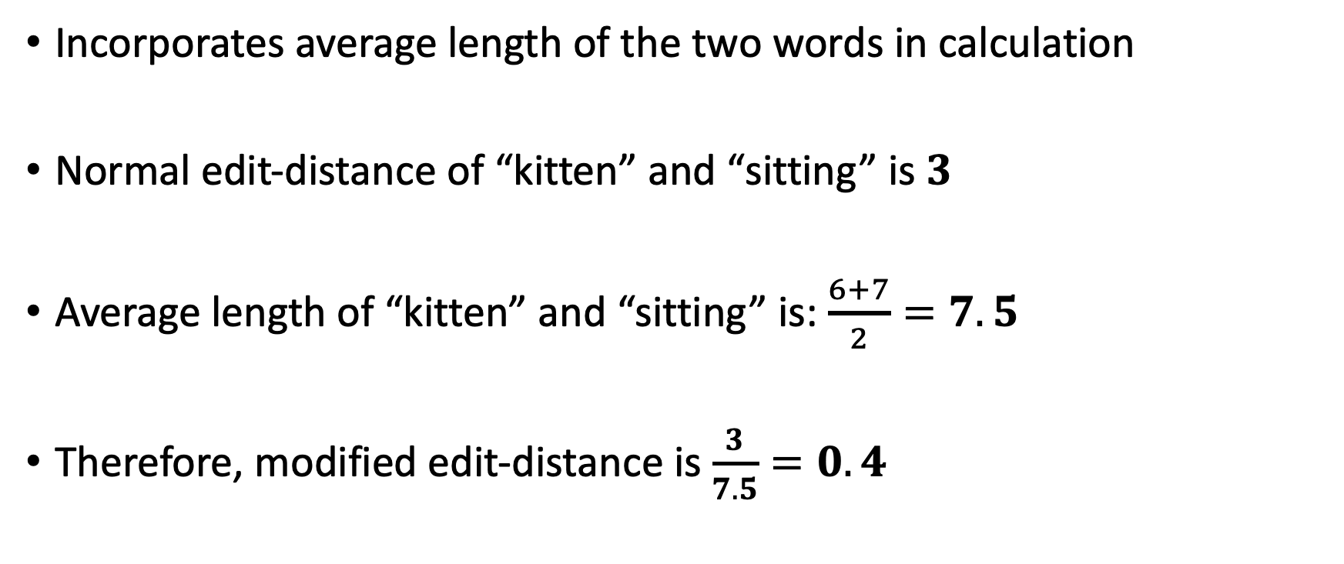
The modified edit-distance
Incorporates average length of the two words in calculation
Normal edit-distance of “kitten” and “sitting” is $3$
Average length of “kitten” and “sitting” is: $\frac{6+7}{2}=7.5$
Therefore, modified edit-distance is $\frac{3}{7.5}=0.4$
Notes:
This project uses a modified edit distance to measure the similarities of two words. This is computed by taking the average length of the two strings to be compared and dividing the normal edit-distance by this.

Slide 27
Finding legitimate name pairs
User name
Screen name
For the name pair: (nurato,ナルト)
Screen name
Transliterated screen name
Standard transliteration
ナルト
naruto
Notes:
With edit-distance in mind.
Name pairs are found by applying a standard transliteration on the screen name,

Slide 28
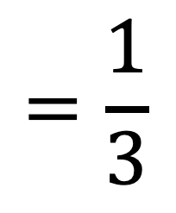
Finding legitimate name pairs
User name
Screen name
For the name pair: (nurato,ナルト)
Screen name
Transliterated screen name
Standard transliteration
ナルト
naruto
(
)
Modified edit distance
$$=\frac{1}{3}$$
Transliterated screen name
User name
naruto
,
nurato
Notes:
And this name is then compared to the user name using the modified edit-distance. If the modified edit-distance between these two names is

Slide 29
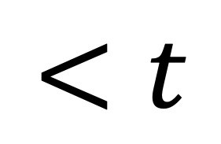
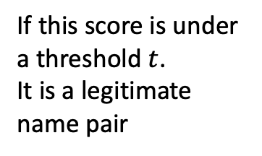
Finding legitimate name pairs
User name
Screen name
For the name pair: (nurato,ナルト)
Screen name
Transliterated screen name
Standard transliteration
ナルト
naruto
(
)
Modified edit distance
$$=\frac{1}{3}$$
Transliterated screen name
User name
$$<t$$
naruto
,
nurato
If this score is under a threshold $t$.
It is a legitimate name pair
Notes:
Under some threshold, we accept this name pair as a legitimate transliteration. The name pairs that survive cleansing go to form the data set that is used to train our name transliteration model.

Slide 30
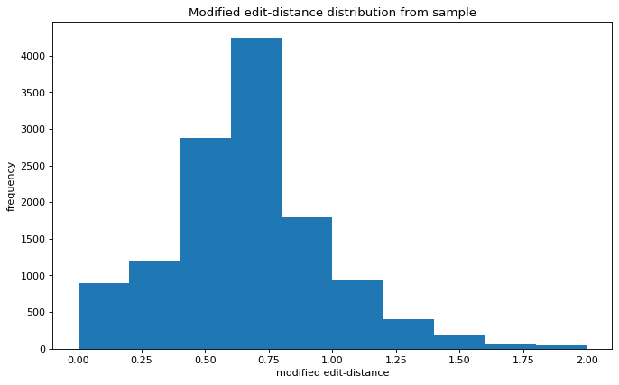
Plot of modified edit-distance distributions
Notes:
To give a bit of context of the amount of data that is cleansed, this plot displays the distribution of modified edit-distances from a sample.

Slide 31
Plot of modified edit-distance distributions
Notes:
You would typically cleanse using a small modified edit-distance threshold from 0 to 0.3. Approximately 90% of the data is removed in the cleansing stage.

Slide 32
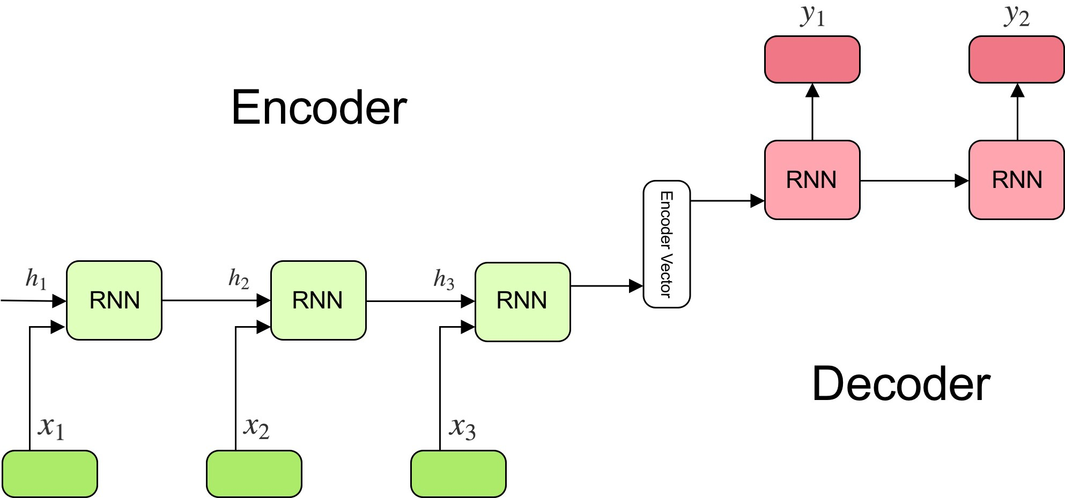
Training – Model Overview
ト
ム
t
o
m
Notes:
Using the data curated, language models can be produced. The specific model used in this project is a character-level recurrent neural network, employing the encoder, decoder architecture. A recurrent neural network was chosen for its ability to deal with time-sequenced data, in the context of this project, a time sequence would be a position of a character on a word. The encoder, decoder architecture is designed for accepting inputs as a sequence and outputting a sequence, which is exactly what name transliteration boils down to.
<ignore below>
We are using a character-level recurrent sequence to sequence model to train data.
A very high level overview, this basically means that there are two layers, the first layer accepts a sequence of user names and produces hidden states. The second sequence takes these hidden states as input and outputs screen names.
We can also think of this as the first layer encoding the user names into the target language and the second layer predicting the next target character given the user name and previous target characters. Character level means that the sequence is made up of characters instead of words.
CHANGE MEANING
Hidden state is a representation
Remove layers connotation – use models
Introduce RNN, what is it, why use it, how to implement it

Slide 33
The Training Dataset
3 different training data sets, cleansed on modified edit-distance threshold of:
0
0.1
0.25
Consequently, 3 different models produced
Notes:
In this project 3 training data sets were produced, these training data sets were cleansed on different modified edit-distance thresholds.
These thresholds being: 0, 0.1 and 0.25
In turn 3 different models were also produced using these three data sets. We will see the differences in these models later on.

Slide 34
Evaluation
3 testing data sets
Each cleansed using different modified edit-distance thresholds
0 Test set 1 – standard transliteration
0.1 Test set 2 – little deviation from standard transliteration
0.25 Test set 3 – some deviation from standard transliteration
Provides different standards of evaluation
Notes:
After our model has been trained, we need to evaluate its effectiveness using unseen testing data. We are using 3 different testing sets, each testing set was produced from the same corpus of testing data but have been cleansed using different modified edit-distance thresholds. The first set is of edit-distance threshold of 0, meaning name pairs are standard transliterations. The second set is of edit-distance threshold of 0.1, meaning there is a little deviation from the standard transliteration. And the last set is of edit-distance threshold of 0.25, meaning there is some deviation from the standard transliteration. The goal of using three test sets is to provide different standard of evaluation.

Slide 35
Results – Model performance
Increasing levels of noise in test set
 | Test set 1 loss | Test set 1 accuracy | Test set 2 loss | Test set 2 accuracy | Test set 3 loss | Test set 3 accuracy
Model 1 | 0.20000 | 0.96616 | 0.52112 | 0.93133 | 1.10194 | 0.88383
Model 2 | 0.20308 | 0.96548 | 0.26792 | 0.95538 | 0.63477 | 0.90794
Model 3 | 0.25096 | 0.95690 | 0.32463 | 0.94320 | 0.45341 | 0.92437
Increasing levels of noise
in training set
Notes:
In terms of model performance, a tabulated view of loss and accuracy can be seen. As expected, the minimum loss and maximum accuracy of the three test sets perfectly lined up with their respective edit-distance threshold models. For example, the model which used data that had been cleansed using 0.25 edit-distance, achieved best results on test set 3, which also had data that had been cleansed using 0.25 edit-distance. This shows that each model has correctly learnt the intricacies of informally transliterating a variety of Twitter name pairs.
Make dynamic, highlight boxes when talking about it
Have a little discussion on model performance
Separate out loss and accuracy???

Slide 36
Results – Model performance
Notes:
Here is the accuracy of the 3 models plotted out over the three testing sets. As you can see as the noise in the testing data increased, the performance of model 1, the one in blue, dropped dramatically. Model 2 had good performances over semi-noisy data and not-noisy data. While Model 3, had overall good performance throughout. We can conclude that noise in the training data, does not have much negative effect on producing transliterations.
Mull over if time

Slide 37
Results – Transliterations
 | Naruto | Yuzu | Lily | Joshua
Model 1 | なると | ゆず | ひいや | ジョシュー
Model 2 | なると | ゆず | りり | ジョシュア
Model 3 | なると | ゆず | りり | じょしあ
Notes:
For a more concrete example of the differences. I present some sample transliterations from the three models.
When transliterating very typical Japanese names, all three models were able to output a standard transliteration.
However, for more atypical names like Lily or Joshua. Models trained on nosier data were able to output more faithful transliterations.
Show standard transliteration of names and show edit distance as well.
In the last case of Joshua, three different variations were produced.
Overview of model performance.
Use Joshua as an example

Slide 38
Results – Things built
A name transliteration pipeline
Robust
Modularised
Works
Many Jupyter notebooks
Examples of pipeline being run
Experiments on cleansing
Notes:
Throughout this project, the overall goal of building a name transliteration pipeline was achieved and the criteria of it being robust, modularised and workable were also achieved.
Many jupyter notebooks showcasing runs of the pipeline and experiments on the pipeline was also achieved.

Slide 39

Future Work
Get better hardware to run all 2,000,000 Tweets
More robust rules
Noise is not bad – less impact than thought of? – reformulate problem for this
Look at training without cleansing
pls buy 4 me
Notes:
Due to hardware constraints, only a fraction of the available Twitter files were used in the final model. An extension of this project would be to run this entire process on better hardware.
More discussion
More investigation into phenomenon found

